Slide 1

Agile Manifesto: Principle #1
“Our highest priority is to satisfy the customer through
early and continuous delivery of valuable software.”
#1 Principle of the Agile Manifesto
12 #Dynatrace

Slide 2


Utmost Goal: Minimize Cycle Time
Customer
Users
feature cycle time
time
2

Slide 3
Utmost Goal: Minimize Cycle Time
Customer
minimize
Users
feature cycle time
time
3

Slide 4

Utmost Goal: Minimize Cycle Time
This is when you create value!
Customer
minimize
feature cycle time
time
4

Slide 5

Utmost Goal: Minimize Cycle Time
This is when you create value!
Customer
minimize
feature cycle time
time
You

Slide 6
Continuous Delivery Deployment Pipeline
...which is at the heart of Continuous Delivery, defined as:
“A deployment pipeline is, in essence, an automated implementation
of your application’s build, deploy, test and release process.”
Jez Humble & Dave Farley in Continuous Delivery

Slide 7
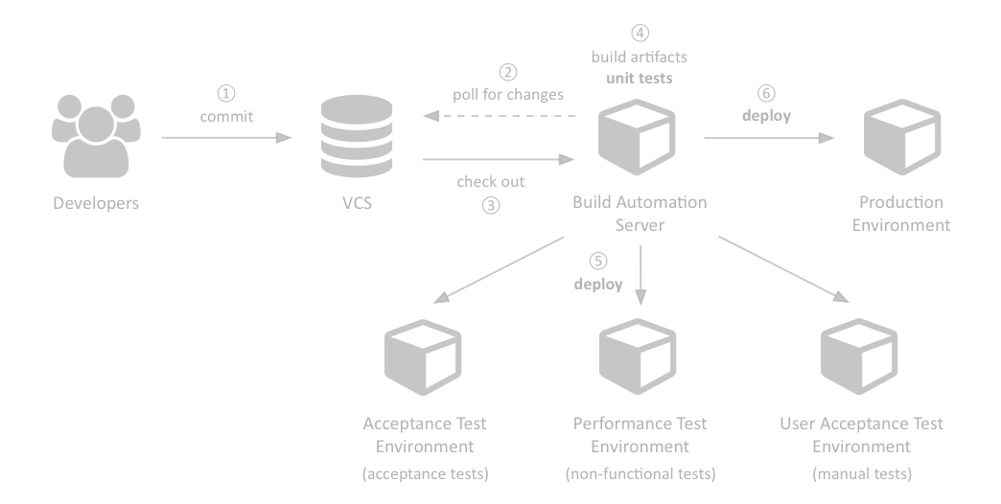
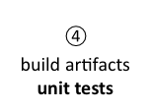
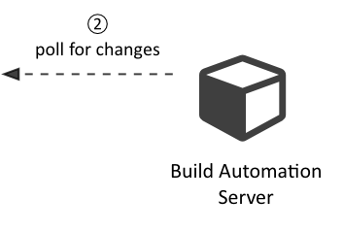
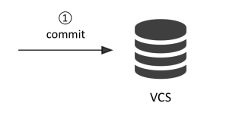
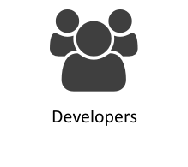
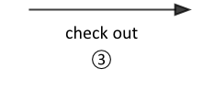
Continuous Delivery Deployment Pipeline
✔

Slide 8
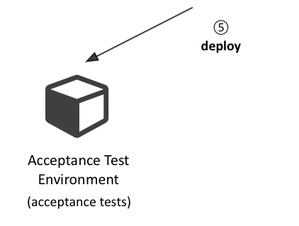
Continuous Delivery Deployment Pipeline
✔

Slide 9
Continuous Delivery Deployment Pipeline
✔
✔

Slide 10
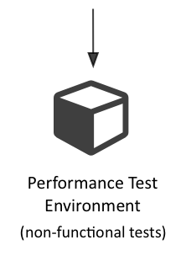
Continuous Delivery Deployment Pipeline
✔
✔
✔

Slide 11
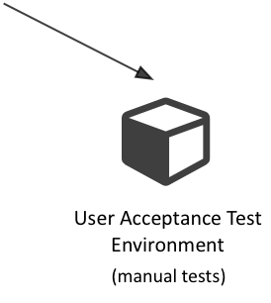
Continuous Delivery Deployment Pipeline
✔
✔
✔
✔

Slide 12
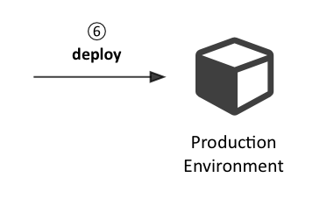
Continuous Delivery Deployment Pipeline
✔
✔
✔
✔
✔

Slide 13
Automated Deployments
Why?
» Create application runtime environments on demand
» Fast, reliable, repeatable and predictable outcomes
» Consistent environments in staging and production
» Establish fast feedback loops you can react upon
» Makes release days riskless, almost boring

Slide 14
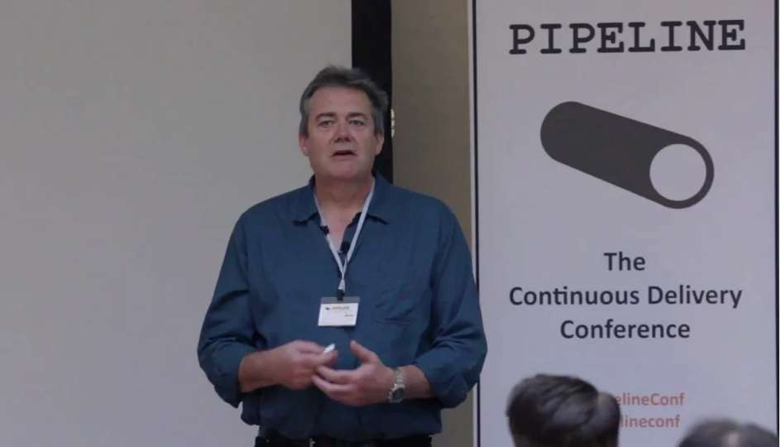


Solve problems and be creative!
Repetitive tasks
“Use machines for what they’re good at, use people for what they’re good at.”
Dave Farley at PIPELINE Conference 2014 @vimeo.com/96173993

Slide 15
Automated Deployments
What?
» Operating Systems, Drivers
» Middleware, Databases, etc.
» Applications, Dependencies, Data
} + Configuration

Slide 16


Automated Deployments
How?
» Infrastructure as Code!
» Keep everything in Version Control
» Code
Everything that affects application state
» Configuration
» Data
» Align Development and Operations

Slide 17
Align Development and Operations
DEVELOPMENT
OPERATIONS
current iteration
(e.g. 2 weeks)
time

Slide 18

Align Development and Operations
Planning
DEVELOPMENT
OPERATIONS
current iteration
(e.g. 2 weeks)
time

Slide 19

Align Development and Operations
Implementing and testing
Planning
DEVELOPMENT
OPERATIONS
current iteration
(e.g. 2 weeks)
time

Slide 20

Align Development and Operations
Implementing and testing
Working and deployable code
Planning
DEVELOPMENT
OPERATIONS
current iteration
(e.g. 2 weeks)
time

Slide 21


Agent-Based Architectures
Examples: Chef, Puppet

Slide 22
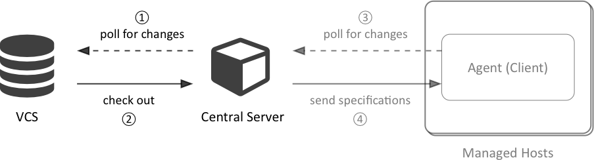
Agent-Based Architectures

Slide 23
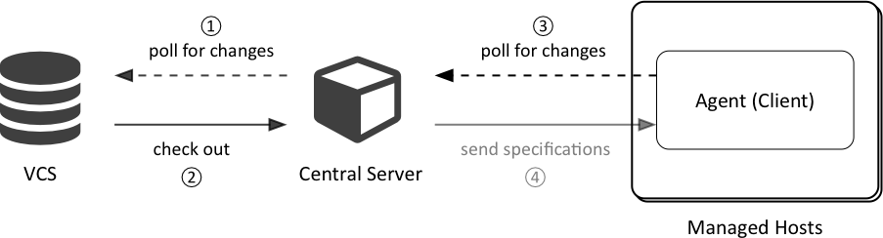
Agent-Based Architectures

Slide 24

Agent-Based Architectures

Slide 25

Agentless Architectures
Examples: Ansible

Slide 26
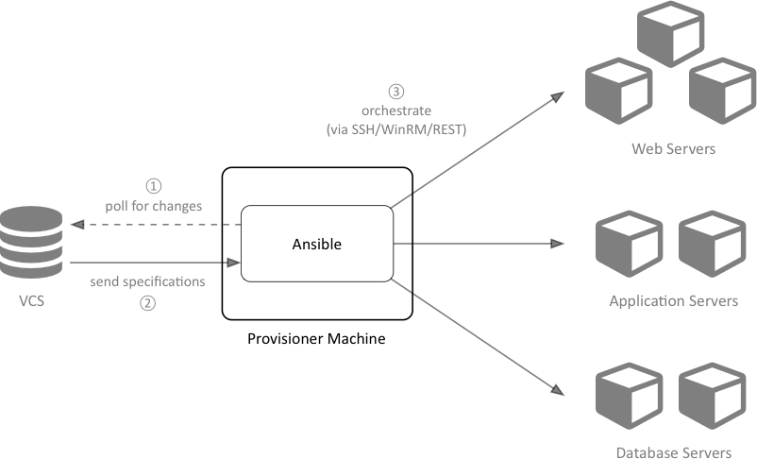
Ansible’s Agentless Architecture

Slide 27

Ansible’s Agentless Architecture

Slide 28
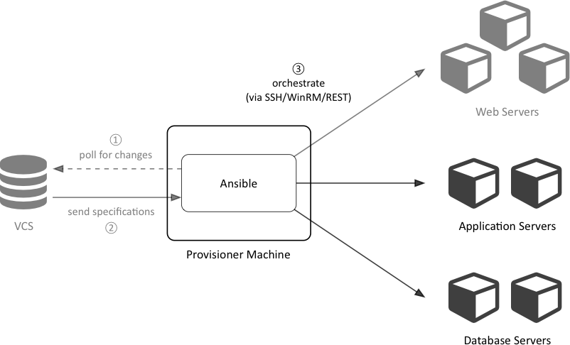
Ansible’s Agentless Architecture

Slide 29

Ansible’s Agentless Architecture

Slide 30

Ansible is an Orchestration Engine

Slide 31

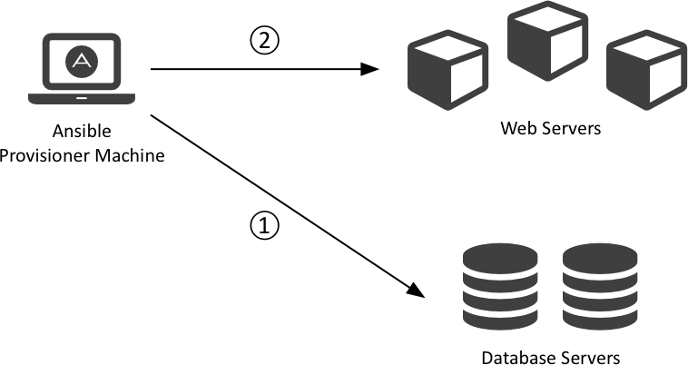
Ansible is an Orchestration Engine

Slide 32
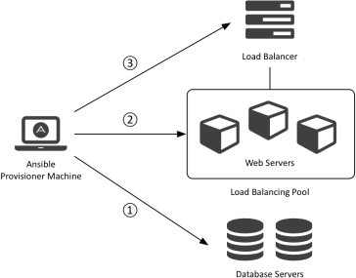
Ansible is an Orchestration Engine

Slide 33
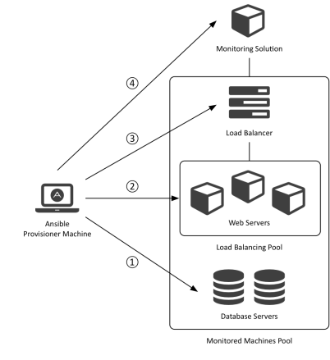
Ansible is an Orchestration Engine

Slide 34
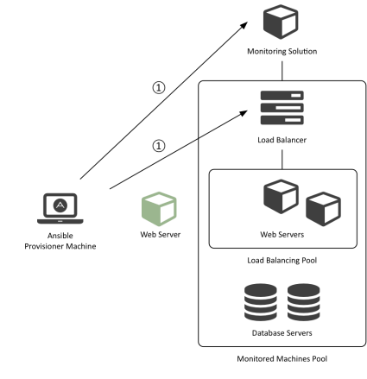
Ansible is an Orchestration Engine

Slide 35
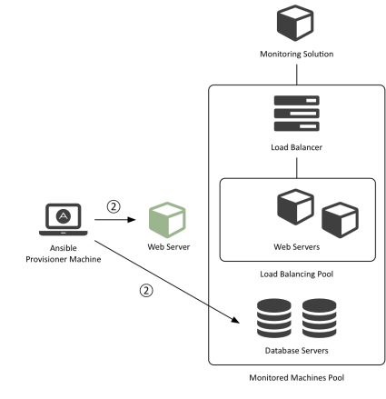
Ansible is an Orchestration Engine

Slide 36
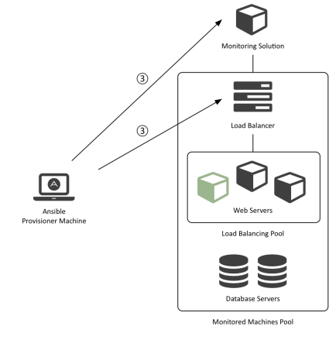
Ansible is an Orchestration Engine

Slide 37
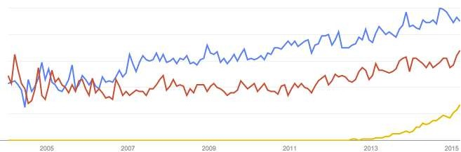








Global Google Trends: Chef vs. Puppet vs. Ansible
Chef
Puppet
Ansible
Year #1

Slide 38
Ansible: Recap of 2014 (first full year of sales)
» Named #1 to watch in 2015 by SD Times
» Named a Top 10 open source project by Red Hat’s opensource.com
» > 1 Million Downloads
» > 40 dedicated Ansible meetups (happen regularly)
» > 300 customers across all verticals (Ansible Tower)
» > 900 contributors on GitHub (one of GitHub’s most active projects)
» AnsibleFest conferences in San Francisco, Austin & New York
» “Ansible: Up and Running” book preview released by O’Reilly

Slide 39


Dynatrace Automated Deployments. So what?
» They integrate nicely into your automated processes!
» Automated Deployments
Agents, Collectors, Servers, Clients, etc. with either of Chef, Puppet or Ansible
» Configuration Management
» Immutable Infrastructure
» Ansible inside the Dynatrace SaaS Orchestration Platform
» Whether on-prem or SaaS: automatically tested

Slide 40
Automated Deployments: What’s the Status?
Ansible Roles
» Dynatrace installations ✓
» Client, Server, Collector, Agents ✓
» Fix Packs, Plugins, Licenses ✓
» Dynatrace Agent injections ✓
» Platforms: Linux ✓ Windows ✓ (soon)
» Soon to come: Agent Groups, PWH Connectivity, etc.

Slide 41
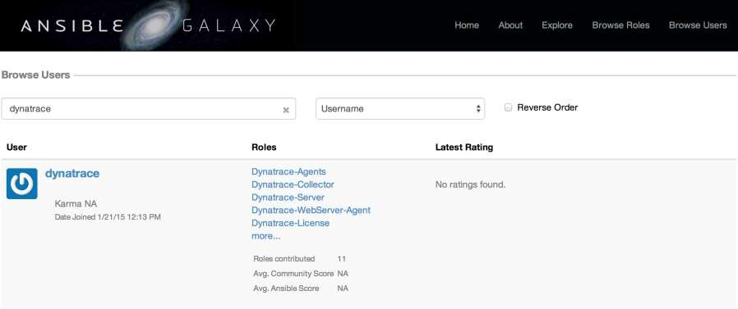
Ansible Galaxy

Slide 42
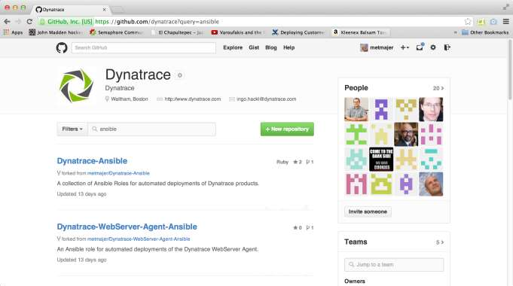
Dynatrace GitHub Organization

Slide 43
Automated Deployments: What’s the Status?
Chef Cookbook
» Customers have provided their own implementions
» We will clean them up and open-source them soon
Puppet Module
» Being developed in-house in our Linz lab

Slide 44
Ansible Concepts: Inventories
Specify the environment Ansible operates in.
» Groups and hosts are defined in inventories
» Use inventories for staging and production
» Text files expressed in an INI-like format

Slide 45
Ansible Concepts: Inventories

Slide 46




Ansible Concepts: Inventories
# production [balancers]
www.example.com
[webservers]
www[0-9].example.com
[dbservers]
db[a:f].example.com
[monitoring]
Group
Host
Numeric Range
Alphabetic Range
dynatrace.example.com

Slide 47
Ansible Concepts: Playbooks
Defines sequences of tasks (Plays) to be executed on a group of hosts.
» Describes policies machines under management shall enforce
» Contains variables, tasks, handlers, files, templates and roles
» Expressed in YAML

Slide 48




















Ansible Concepts: Playbooks
--- # webserve_{D}rs_{o}._{c}y_{u}m_{m}l_{entation}
- h_{M}o_{o}st_{d}s_{u}:_{le}webserve_{A}r_{rgu}s _{mentsGroup of hosts}
tasks:
- name: Install Apache _{V}H_{a}T_{r}T_{ia}P_{b}S_{le}erver
List of plays
apt: name=apache2 update_cache=yes
- name: Install Apache Modules
apache2_module: name={{ item }} state=present
Notify h^{w}a^{i}n^{t}d^{h}l_e^{i}r^{tems:}
List of tasks
proxy
proxy_httpd
notify: reload apache2
handlers:
- name: reload apache2
ODenblyoouncsetadte change
Restart service
service: name=apache2 state=reloaded
remote_user: deploy
sudo: yes

Slide 49
Ansible Concepts: Playbooks

Slide 50


Ansible Concepts: Playbooks
One to rule them all
--- # playbook.yml
include: dbservers.yml
include: webservers.yml
include: balancers.yml
include: monitoring.yml

Slide 51
Ansible Concepts: Roles
The best way to organize your playbooks.
» Structure content into related vars, tasks, files, handlers, etc.
» File structure for automated inclusion of role-specific content
» Roles can be shared and pulled from Ansible Galaxy, GitHub, etc.

Slide 52


Deployment Automation of Dynatrace
with Ansible
in 3 simple steps

Slide 53
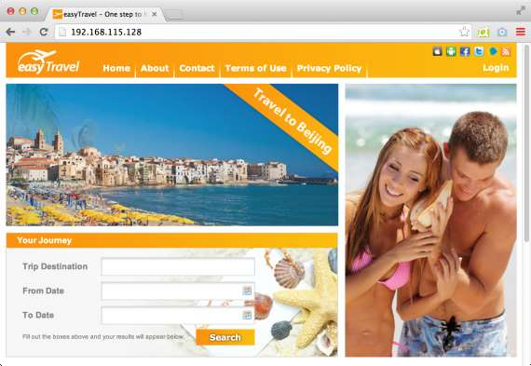
Simulated Production Environment: easyTravel

Slide 54
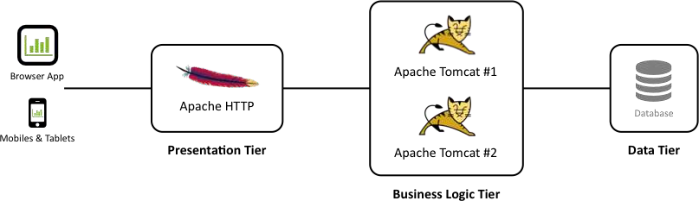
Simulated Production Environment: easyTravel

Slide 55
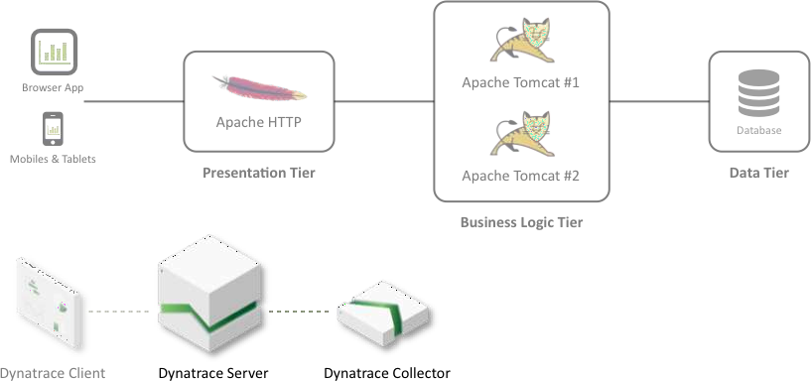
Deployment Scenario I: Install Server & Collector

Slide 56
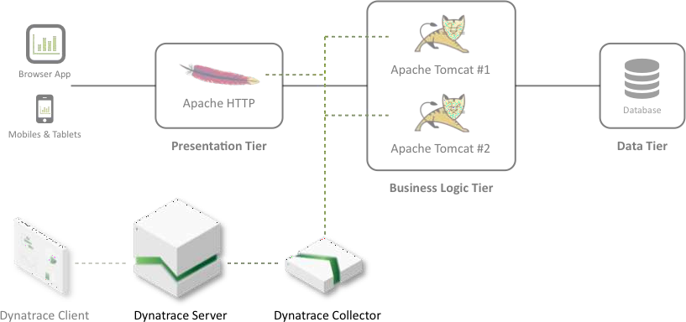

Deployment Scenario II: Inject Agents

Slide 57
Deployment Scenario: Install Server & Collector

Slide 58
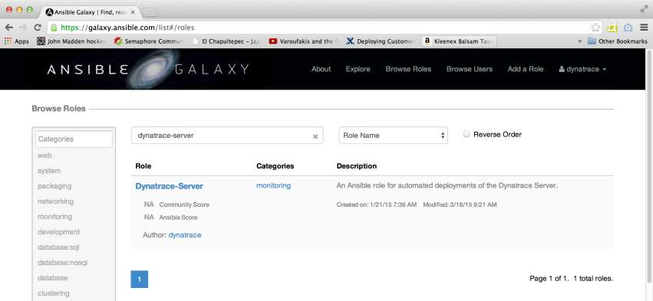
Ansible Galaxy: Dynatrace-Server

Slide 59
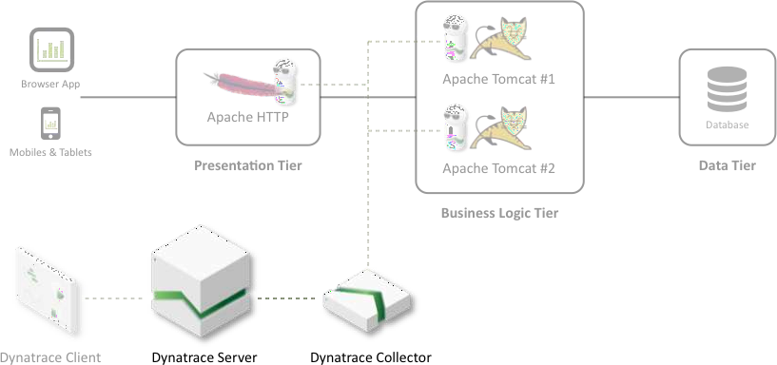




Identify Hosts
dynatrace.easytravel.com
Monitoring

Slide 60
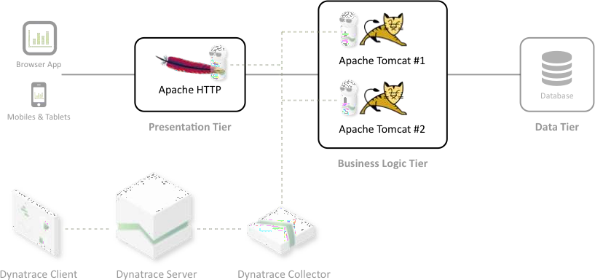




Identify Technologies
Apache HTTP Server
Apache Tomcat

Slide 61
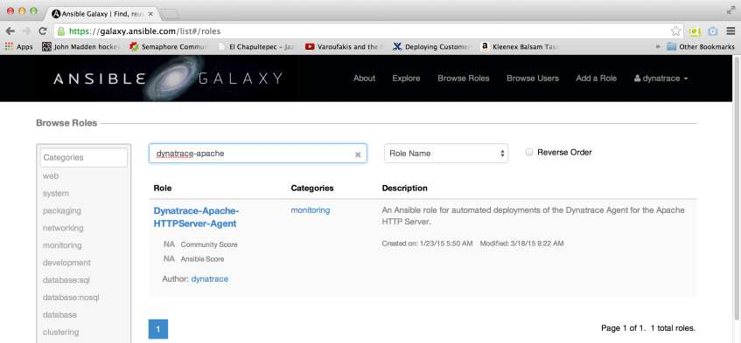
Ansible Galaxy: Dynatrace-Apache-HTTPServer-Agent

Slide 62
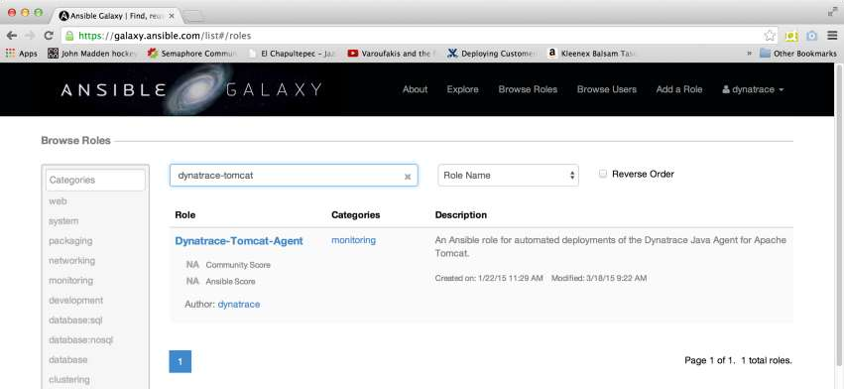
Ansible Galaxy: Dynatrace-Tomcat-Agent

Slide 63










Identify Hosts
Web Server
frontend.easytravel.com
backend.easytravel.com
www.easytravel.com
Application Servers

Slide 64
Additional Resources
Blogs
» Continuous Delivery 101: Automated Deployments
» How to Automate Enterprise Application Monitoring with Ansible
Presentations
» Automated Deployments: Hands-On Training
» Dynatrace Inside Continuous Delivery
Tutorials
» Automated Deployments with Dynatrace and Ansible

